Slide 1
How to use: R projects, Git / GitHub, R Markdown / R Bookdown
Training notes by Jono Handley

Slide 2
What are these things
R Projects
Think of this as a folder you can share which keeps all your R files together
So instead of sending someone your ‘R Script’ and ‘data file’ and ‘outputs’, etc., you can just send them your R Project folder.
The great thing is, everything works on relative file paths, so no more need to fiddle with setting working directories.
Once you share the folder with someone, the R project configuration file should do the job of linking up all the various files.
NOTE: An project is essentially a folder containing a particular configuration file that ties everything together.
Git / GitHub
These are great tools if you want to do the following online:
save / backup your code online
share your code / data / instructions about your code with others
easily work with others to enhance your code
R Markdown
Supports you to create documents about your work in R.
So, if you wanted to show someone how you did an analysis in R, and you wanted to include descriptive text / code / outputs (e.g. figures), you could create a Markdown document.

Slide 3
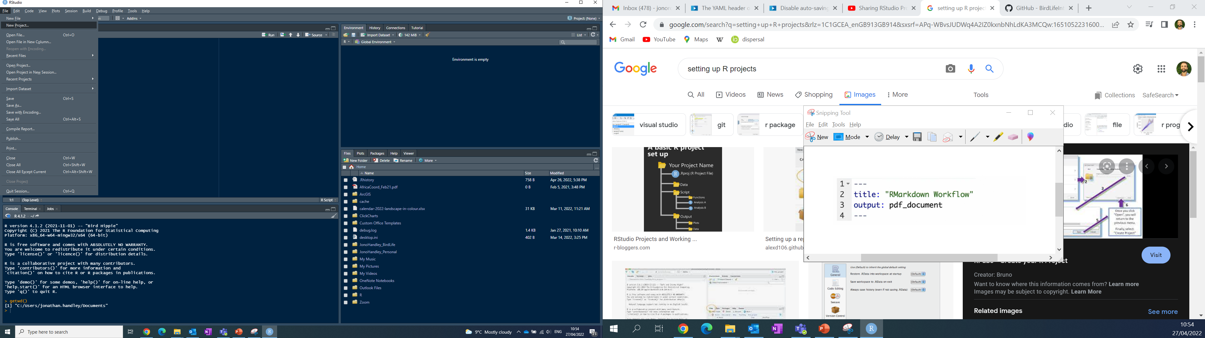
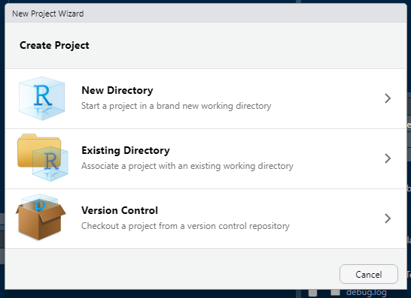
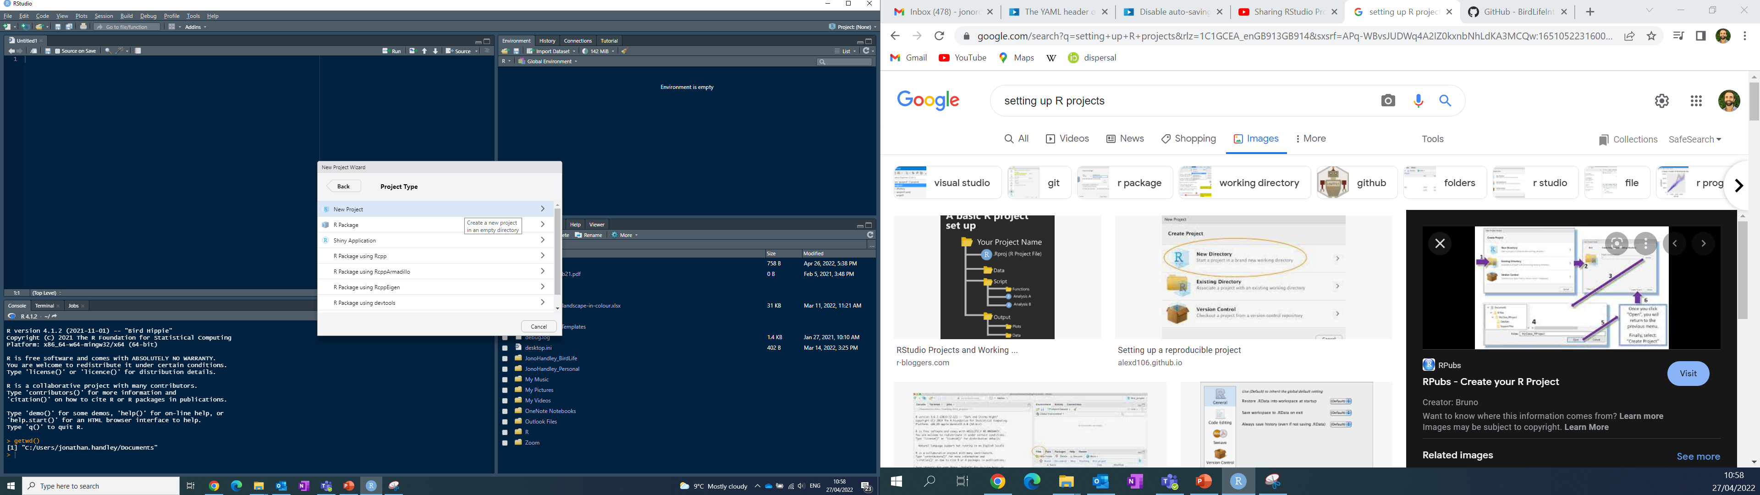
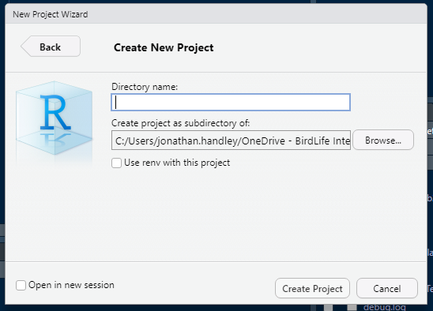
R Projects (Best for your local machine)
For new projects – it’s best to create an “R Project”
R Project = folder you can easily share.
Benefit of R Project: Files are stored in relative paths
i.e. I can share the R Project folder with someone else and they won’t need to worry about setting the working directory or changing where different files are stored.
New project
Associate where it goes
Select type
Specify name

Slide 4
GitHub (Best for online sharing / collaboration)
Quick guide to getting GitHub working from Rstudio:
See website blog
The blog covers:
Installing Git (Git = the “magic software” required to operate GitHub)
Note: you might have Git installed already – google how to see if you do.
Creating a GitHub account (GitHub = the online platform for code sharing and collaboration)
Creating a Repository on GitHub (Repository = similar to a folder with all your relevant documents)
Linking Rstudio and GitHub, and getting files online
The blog DOES NOT cover:
What an R Project is
More detailed guidance on how to use GitHub effectively

Slide 5
GitHub – using it “effectively” (i.e. how a bumbling biologist might use it)
Remember: GitHub is the ‘tool’ that allows you to run Git
Git = the “magic software” required to interact with GitHub
The workflow to operate GitHub (via RStudio) goes something like this:
Key terms:
Clone
Pull
Stage
Commit
Commit message
Push
Branch
Fork
Pull Request
1: Create a repository (aka a repo)
2: Clone (aka copy or link) the repository to your computer
3: Pull the latest version of online code to your computer
4: Stage – this is where temporary files on your computer live
5: Commit and Push the new files online to GitHub
6: Create a Branch or Fork
7: Submit and merge a Pull request

Slide 6
GitHub – using it “effectively” (i.e. how a bumbling biologist might use it)
Remember:
GitHub is a service that can host code repositories created by git, with additional collaboration features (See also: gitlab, bitbucket)
Git = the “magic software” required to interact with GitHub
The workflow to operate GitHub (via RStudio) goes something like this:
Key terms:
Clone (download a remote code repository)
Pull (synchronize code from remote to local)
Stage (tell git that files have changed)
Commit (tell git to save a snapshot of changed files)
Commit message
Push (synchronize code from local to remote)
Branch (a parallel copy of your code within your own repository)
Fork (a github feature: a copy of a repository that belongs to a different Github user)
Pull Request (a github feature: a request to synchronize between branches ofr forks))

Slide 7
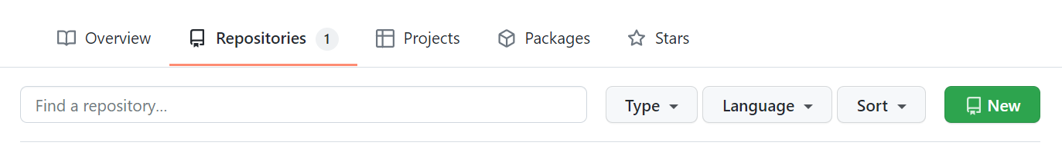
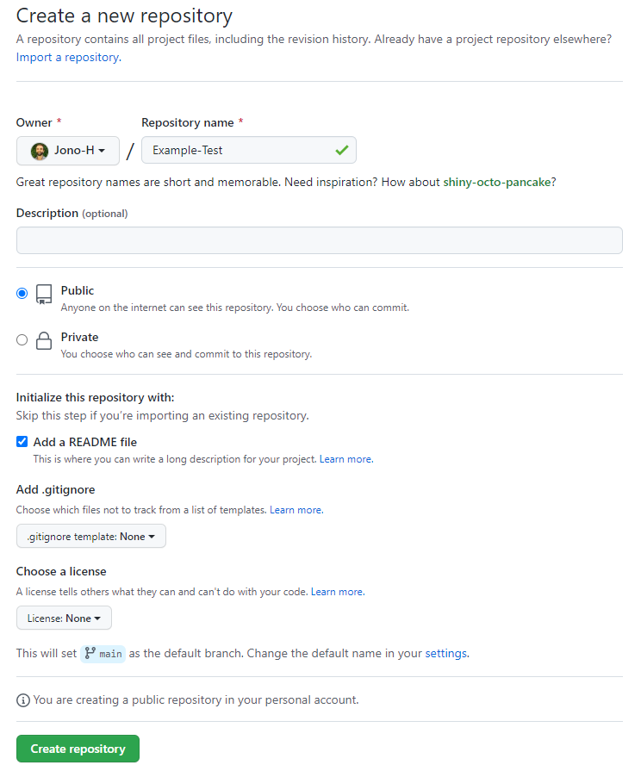
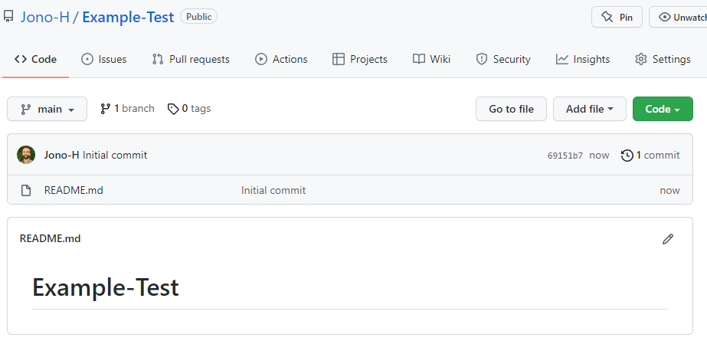
Typical GitHub workflow – from a bumbling biologists perspective
1: Create a repository (aka a repo)
Assuming, you have installed Git and Rstudio (v4 or greater)
1
In your online GitHub account, at the start of a new analysis / new project, create a Repository (aka repo). This is sort of equivalent to a folder in which you would have all your relevant files.
NB: When you create the new repository, Select the option to include a readme file.
2
3
Your repository should look something like the below
Give a name to the repository (repo)
Select visibility
Select option to include readme (like an instruction file)

Slide 8
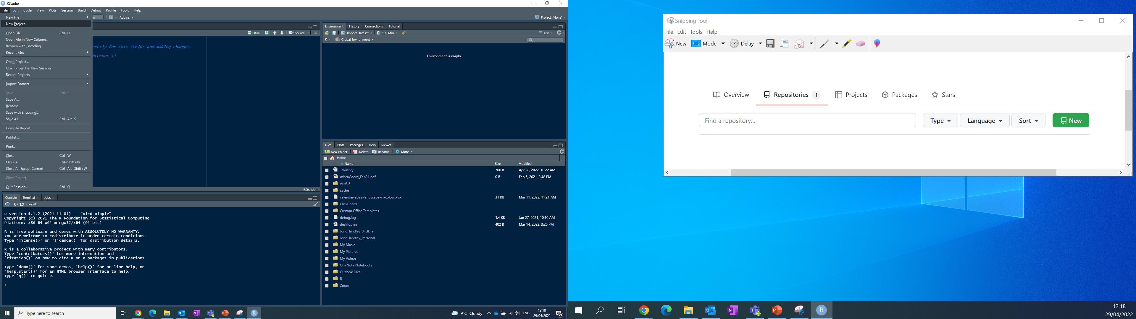
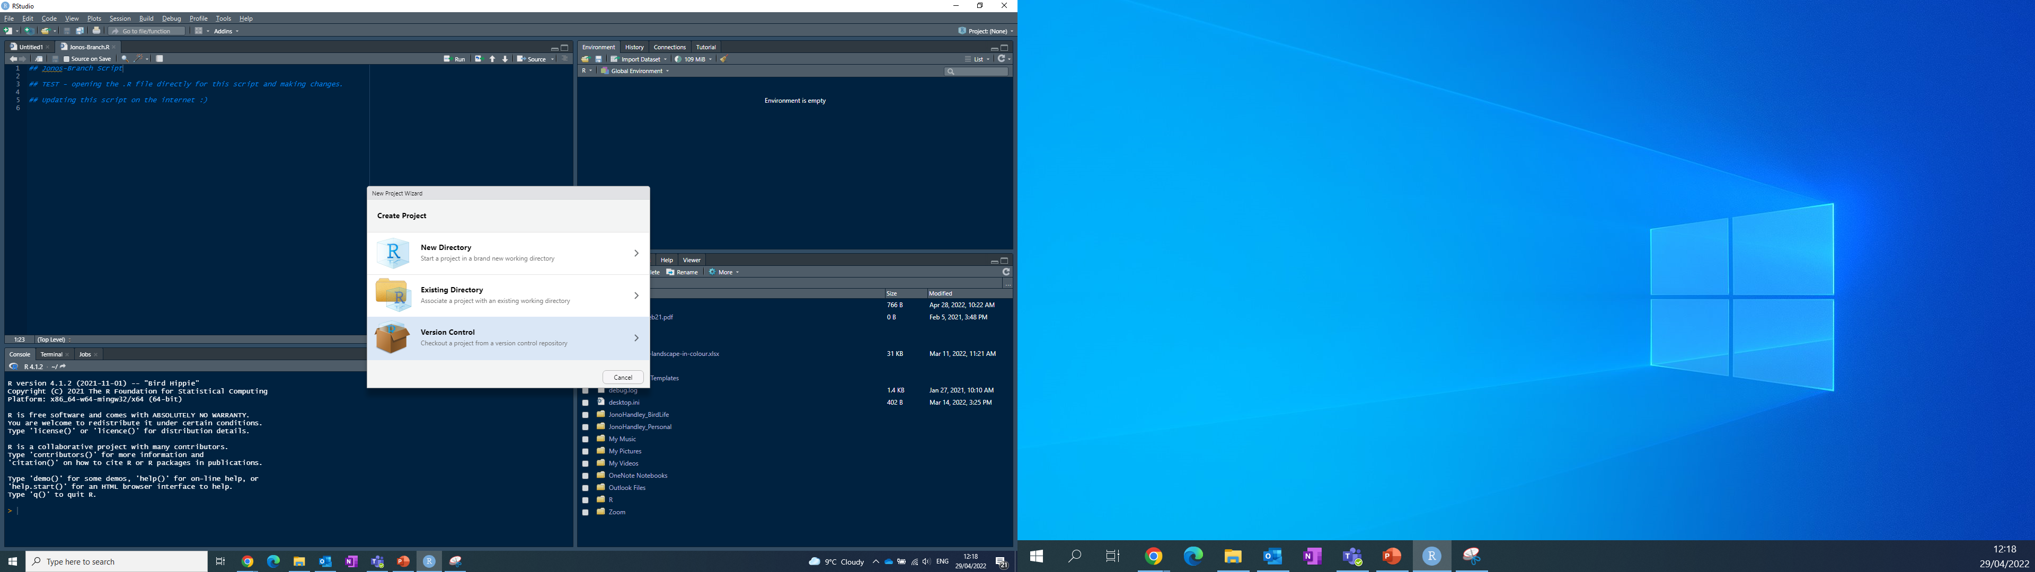
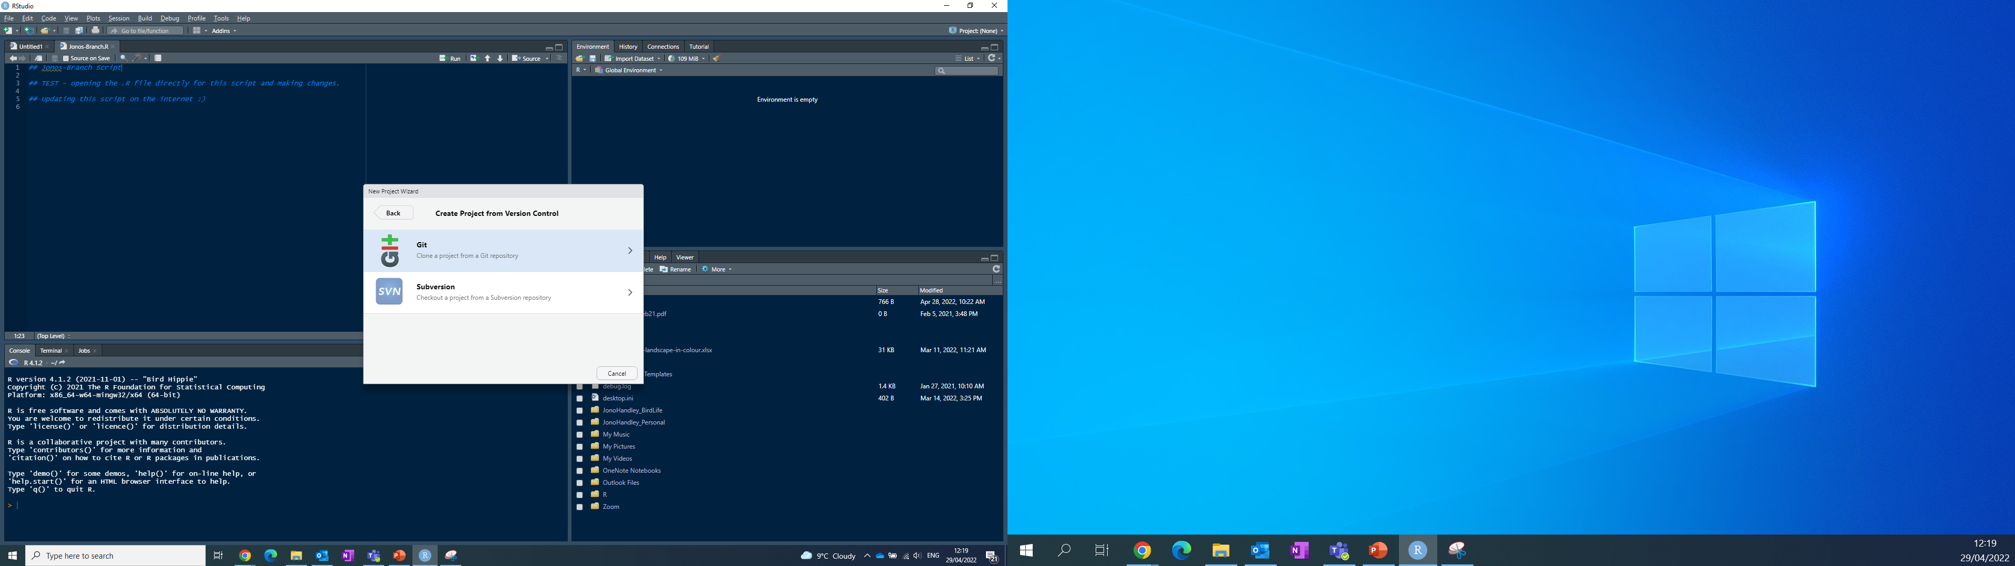
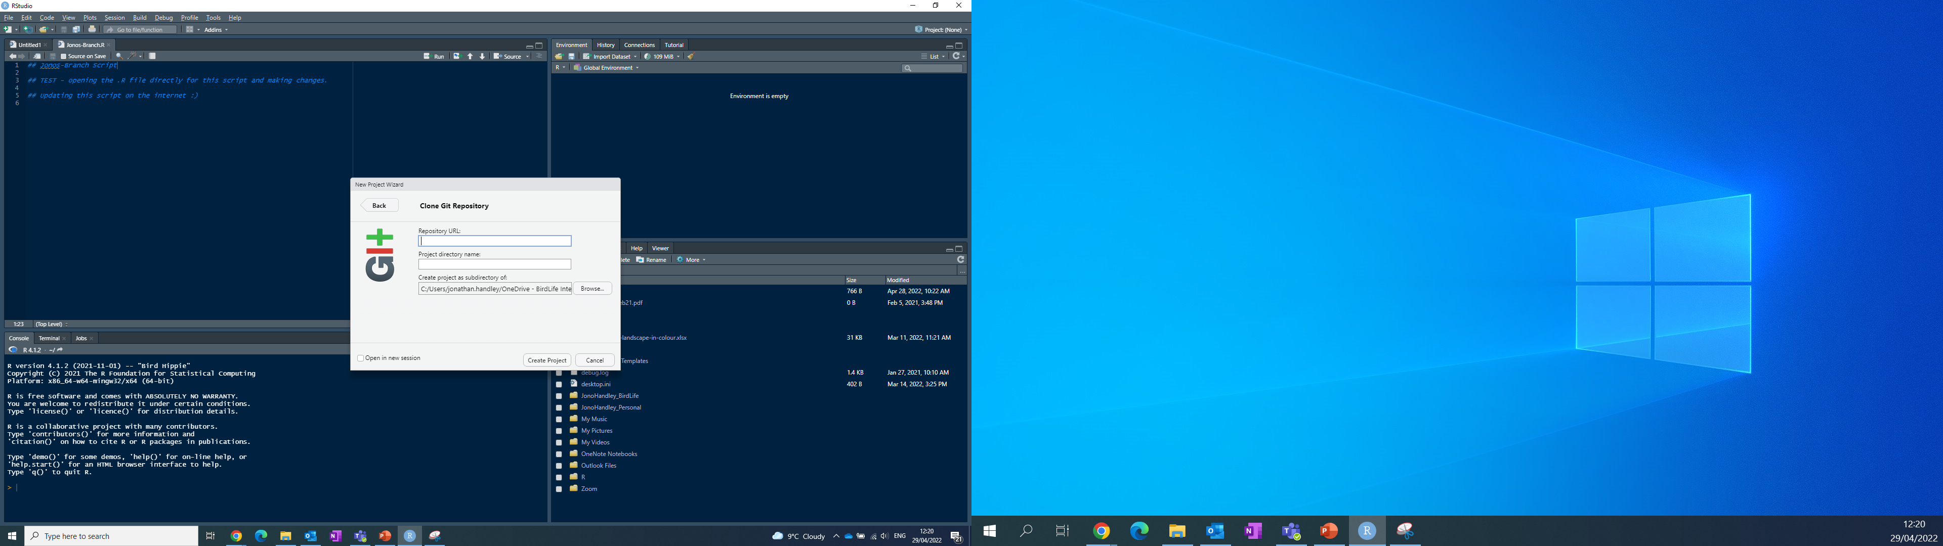
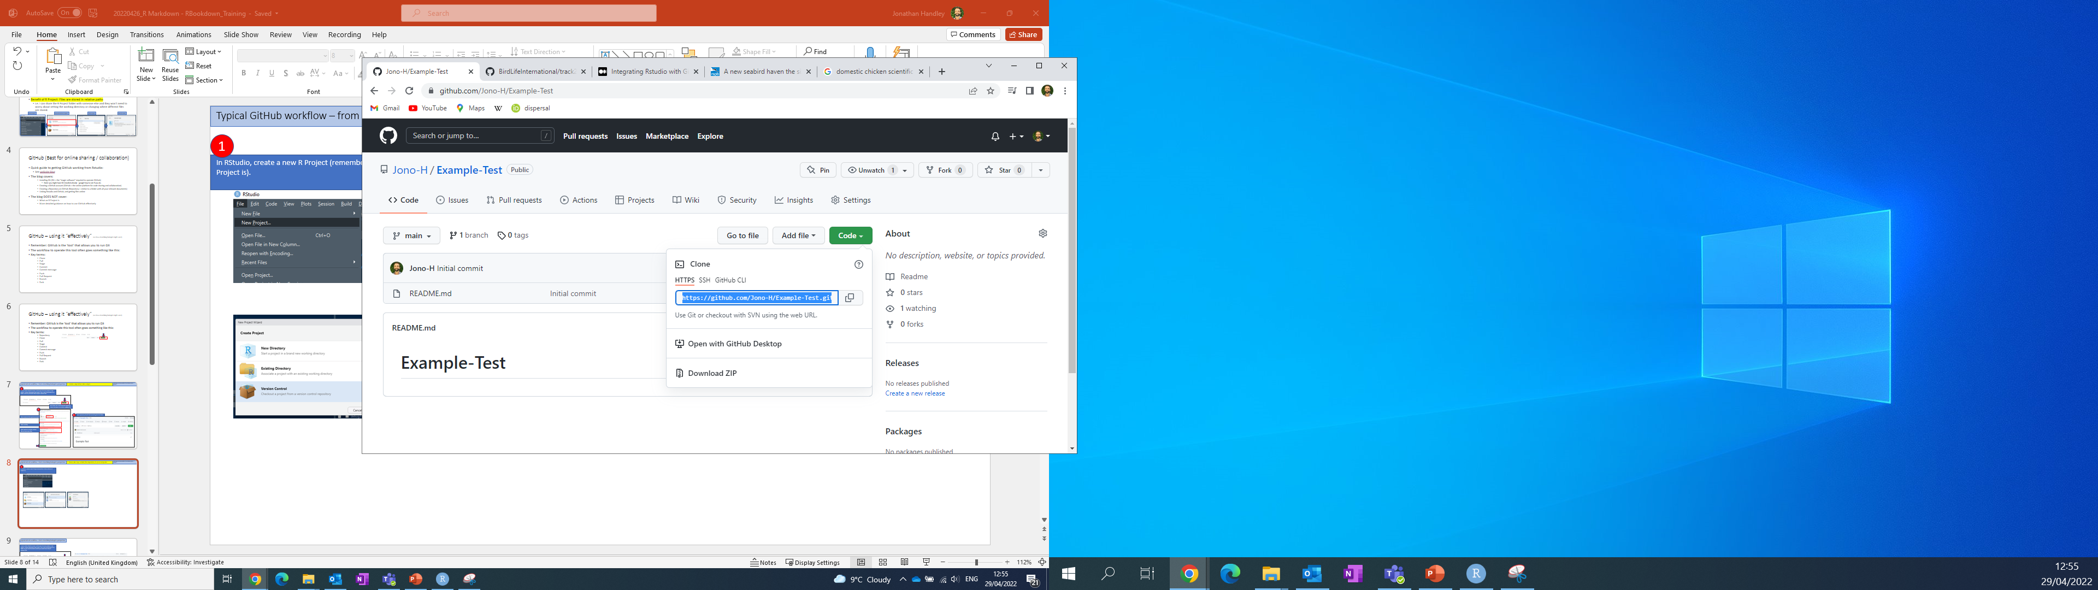
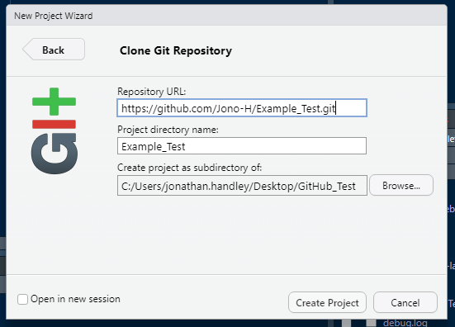
Typical GitHub workflow – from a bumbling biologists perspective
2: Clone (aka copy or link) the repository to your computer
Assuming, you have installed Git and Rstudio (v4 or greater)
1
In RStudio, create a new R Project (remember to learn what an R Project is).
Navigate back to GitHub for the URL
2
Under the ‘Code’ tab, copy the URL from the HTTPS option
Paste the URL.
After you create, notice how R Studio changes appearance! Next slide
Name taken from repo.
Place in relevant folder on your machine.

Slide 9
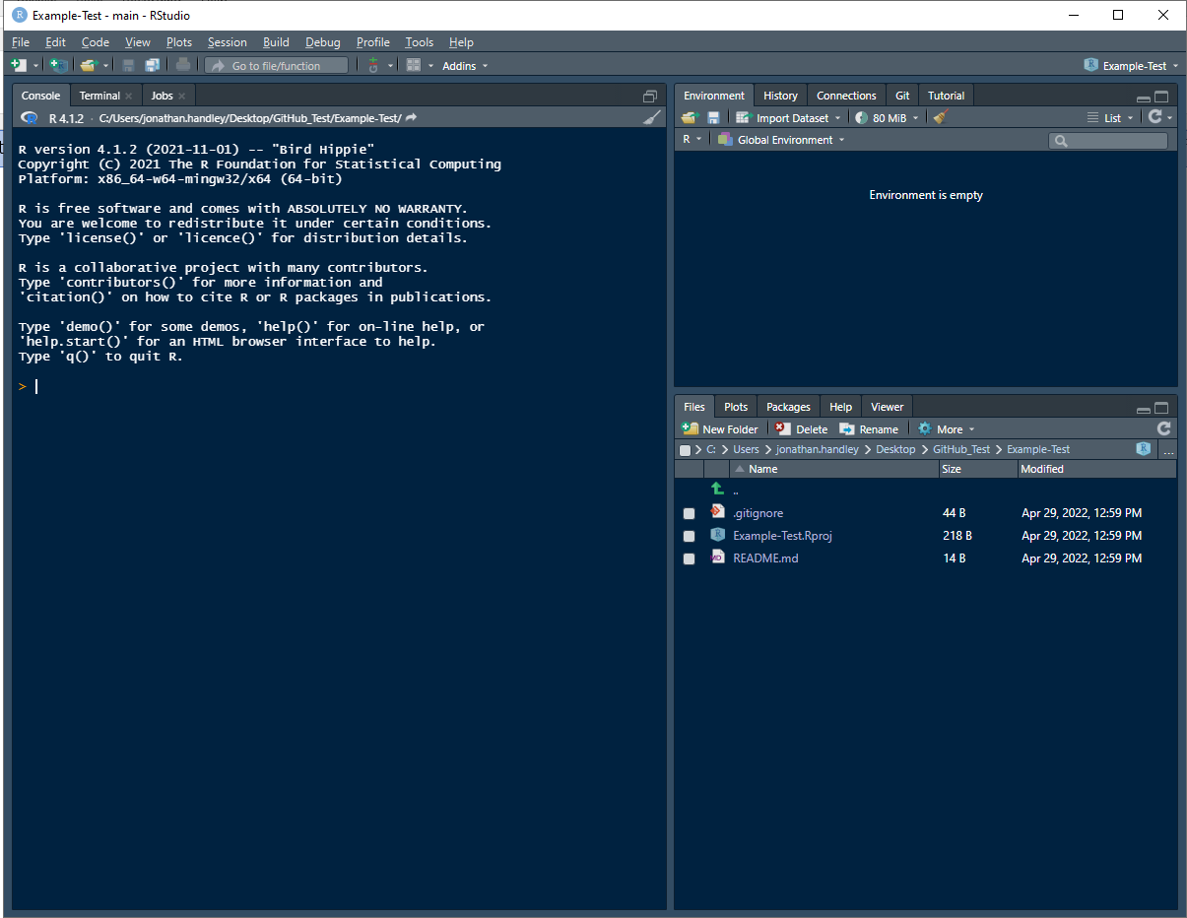
Typical GitHub workflow – from a bumbling biologists perspective
2: Clone (aka copy or link) the repository to your computer
Assuming, you have installed Git and Rstudio (v4 or greater)
The name of the project displays, notifying you are working in a project
The Git tab appears
3
The file structure inside your project is visible
Congratulations, you have cloned the repository to your machine!

Slide 10
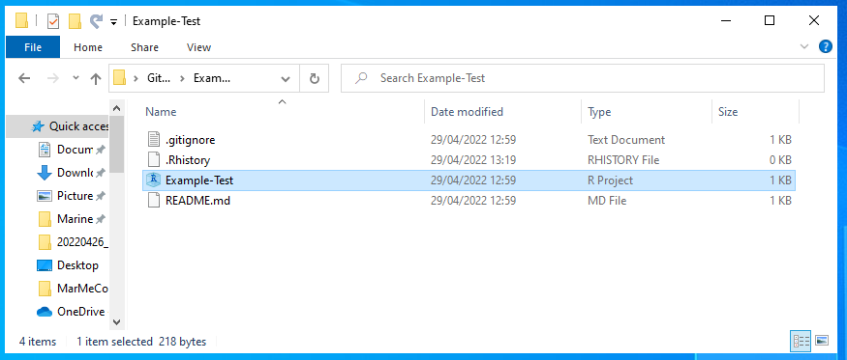
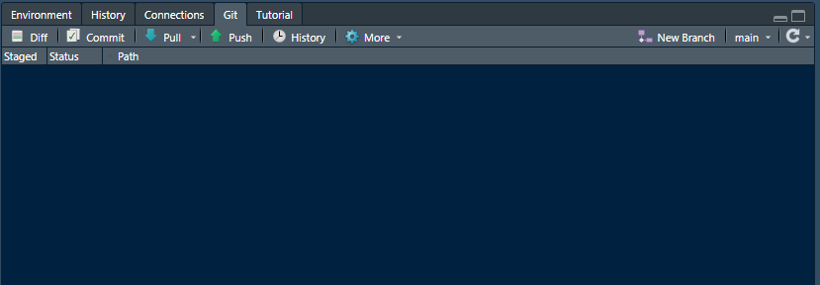
Typical GitHub workflow – from a bumbling biologists perspective
3: Pull the latest version of online code to your computer
Assuming, you have installed Git and Rstudio (v4 or greater)
1
When you start working, open the R Project file on your computer
2
In the Git tab in RStudio, click ‘Pull’
This will Pull all the latest files of the project to your machine
Take note of which Branch you are working in. More info later!
CAVEAT! May want to understand a ‘Fetch’ option which can come before the ‘Pull’

Slide 11
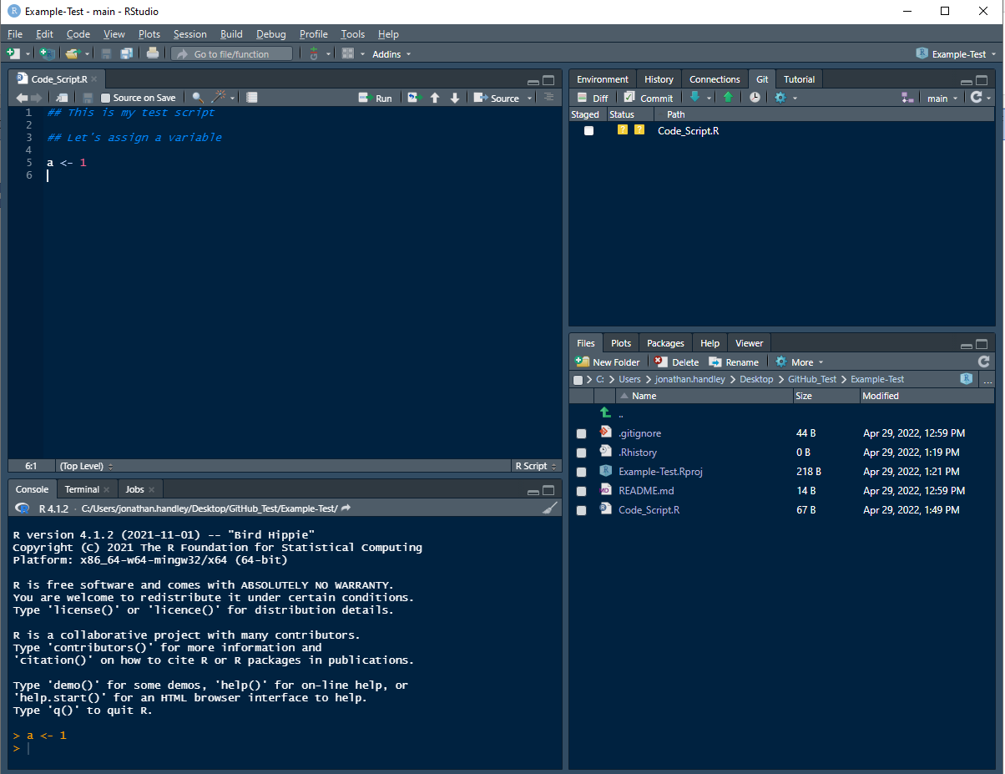
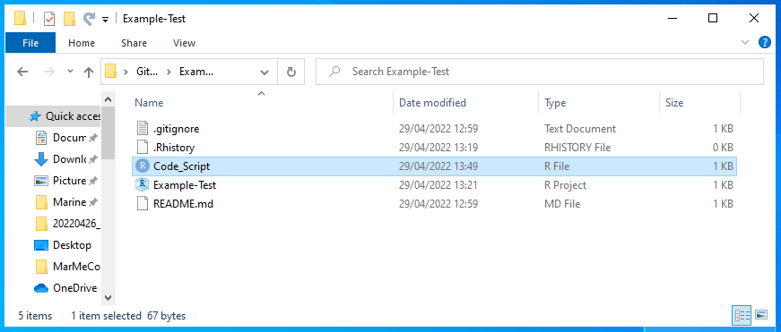
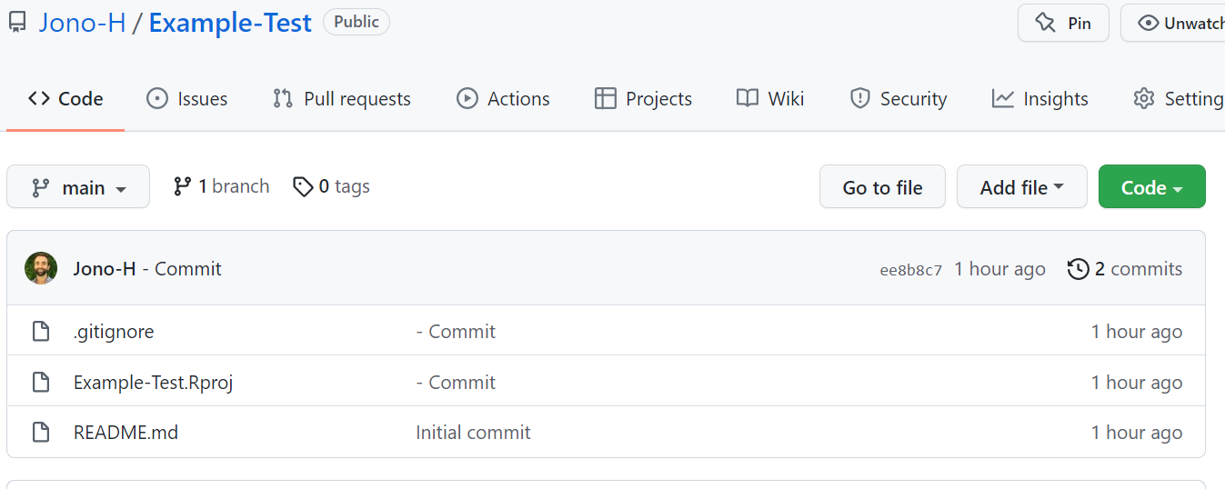
Typical GitHub workflow – from a bumbling biologists perspective
4: Stage – this is where temporary files on your computer live
Assuming, you have installed Git and Rstudio (v4 or greater)
Once you create a new script and then save it, it will get Staged.
Think of this like the file being prepared for going online.
You can see your saved script on your computer
But you won’t see it online on GitHub

Slide 12
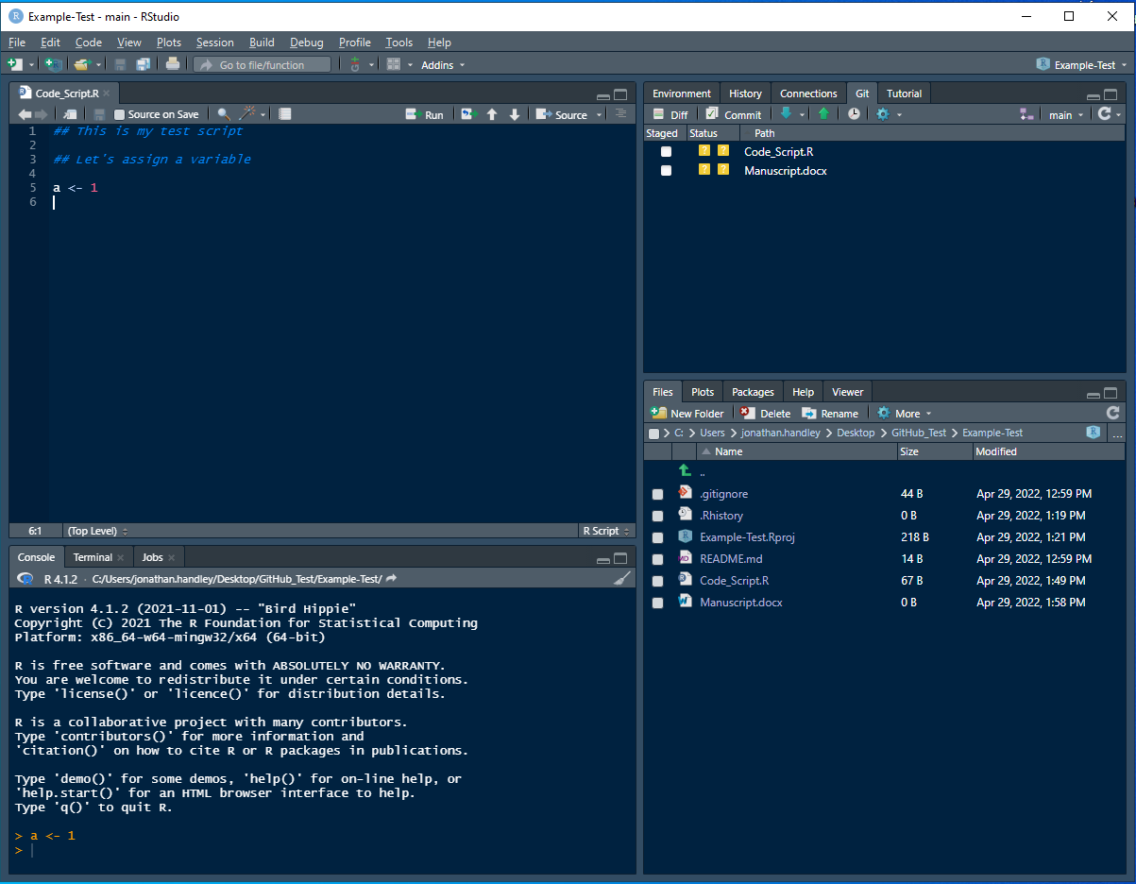
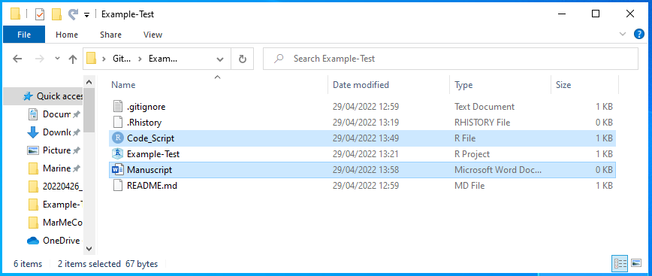
Typical GitHub workflow – from a bumbling biologists perspective
4: Stage – this is where temporary files on your computer live
Assuming, you have installed Git and Rstudio (v4 or greater)
Once you create a new script and then save it, it will get Staged.
Think of this like the file being prepared for going online.
If you create OTHER file types – they will also be staged
You can see your saved script on your computer
But you won’t see it online on GitHub

Slide 13
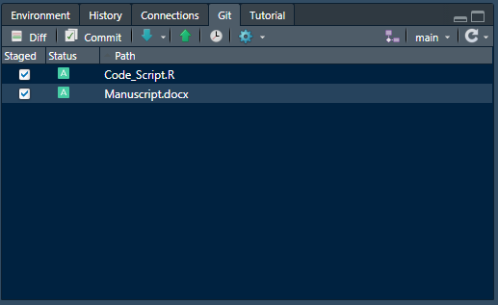
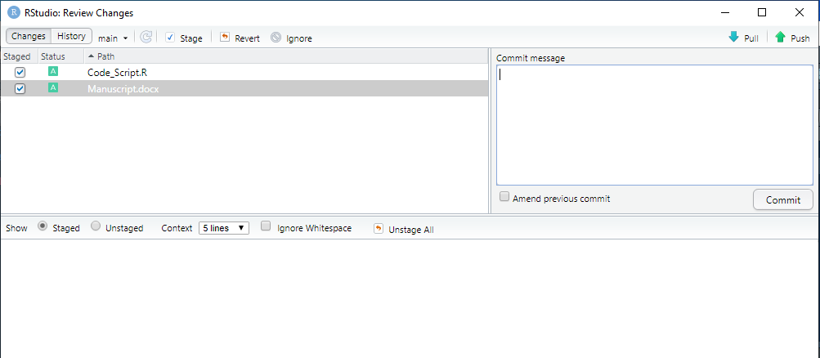

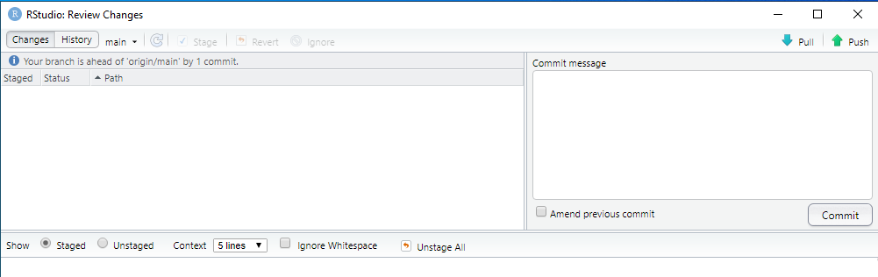
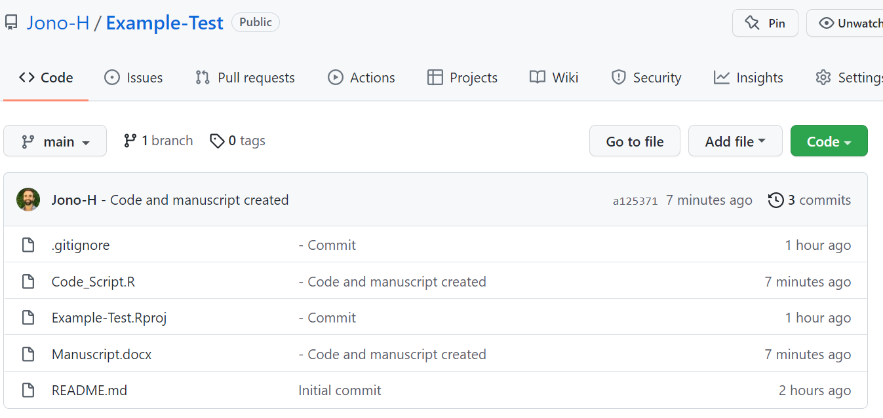
Typical GitHub workflow – from a bumbling biologists perspective
5: Commit and Push the new files online to GitHub
Assuming, you have installed Git and Rstudio (v4 or greater)
1
1. Select the staged files you want to commit
2
2. Select option to commit the files
3
3. A new window appears
4
7
6
Type a commit message in this box.
A commit message is a short description of what you have done to a relevant document
5
6. Notice the text explaining the status of your branch (see later explanation)
7. Push the changes to GitHub
4. Type a commit message
5. Select commit and wait for it to run. Assess output then close output window
8. Your new files should now be online on GitHub ☺.
You may need to refresh the webpage.
8

Slide 14
Typical GitHub workflow – from a bumbling biologists perspective
RECAP – Steps 1 - 5
Assuming, you have installed Git and Rstudio (v4 or greater)
So far, we have covered:
The basic workflow of what you will need if only working on code by yourself.
1: Create a repository (aka a repo)
If you want to work on and edit code with other people
The following will help:
2: Clone (aka copy or link) the repository to your computer
3: Pull the latest version of online code to your computer
4: Stage – this is where temporary files on your computer live
5: Commit and Push the new files online to GitHub

Slide 15
Typical GitHub workflow – from a bumbling biologists perspective
RECAP – Steps 1 - 5
Assuming, you have installed Git and Rstudio (v4 or greater)
So far, we have covered:
The basic workflow of what you will need if only working on code by yourself.
1: Create a repository (aka a repo)
If you want to work on and edit code with other people
The following will help:
2: Clone (aka copy or link) the repository to your computer
3: Pull the latest version of online code to your computer
6: Create a Branch or Fork
4: Stage – this is where temporary files on your computer live
7: Submit and merge a Pull request
5: Commit and Push the new files online to GitHub

Slide 16
Typical GitHub workflow – from a bumbling biologists perspective
6: Create a Branch or Fork
Assuming, you have installed Git and Rstudio (v4 or greater)
What is a branch or fork?
Branch – typically used for safely editing the main repository
Fork – typically used for creating something new and independent
Repository (aka repo)
This is the main (aka master) version of the project
It’s the version people will use. So you don’t want to break it!
Branch
This is a copy of main repository that is still linked to the main repository
But, it’s like a side split from the main repository where you can safely make changes and test them out.
You would normally make changes to a single part of the project. (e.g. just change one specific function)
If the changes are good, these changes can be pulled back into the main repository
Fork
This is an independent copy of the main repository
You usually do this if you want to create something entirely new.
The owner of the main repository, will get a request to review the desired changes.
You can make changes to your branch
Then, you submit a Pull Request to the main repository
BUT, you can also request the changes to be pulled back into the original repository

Slide 17
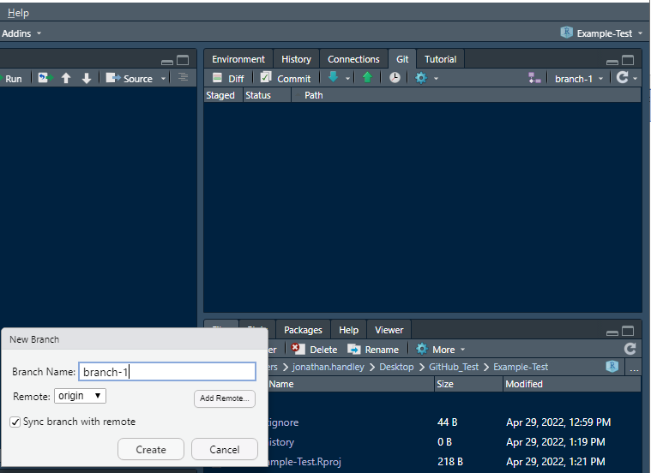
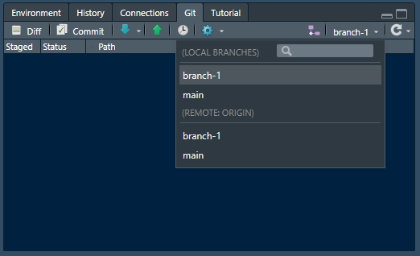
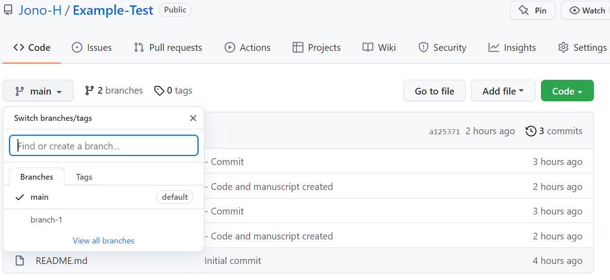
Typical GitHub workflow – from a bumbling biologists perspective
6: Create a Branch or Fork
Assuming, you have installed Git and Rstudio (v4 or greater)
Creating a new branch
Notice on GitHub – you only have 1 branch after creating a repository
3
1
4
2
4. In GitHub, you should now see the different branches.
3. You can click the dropdown to see the different branches that exist.
(Remote:origin) relates to online GitHub
(Local Branches) relate to your computer
1. In RStudio, select the option to create a new branch
2. Give the branch a name

Slide 18
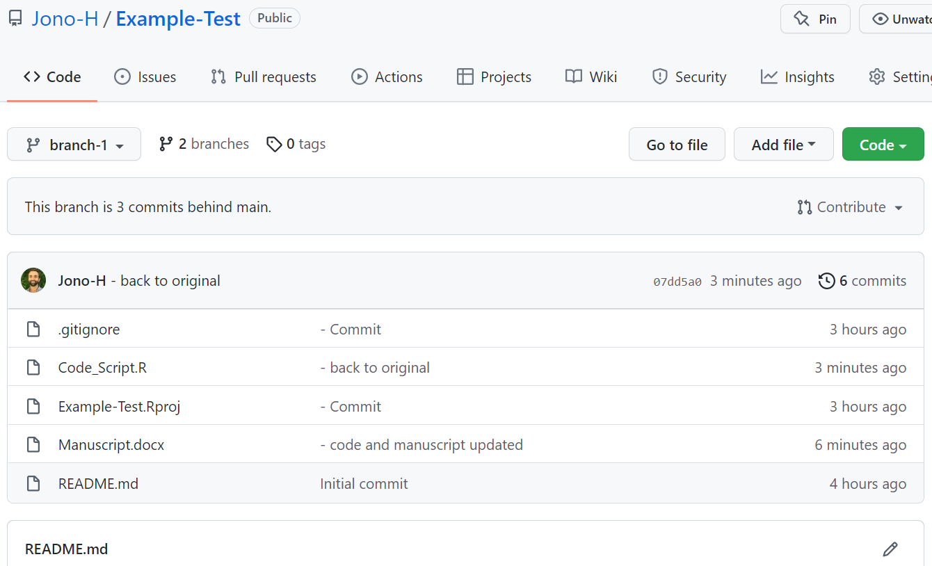
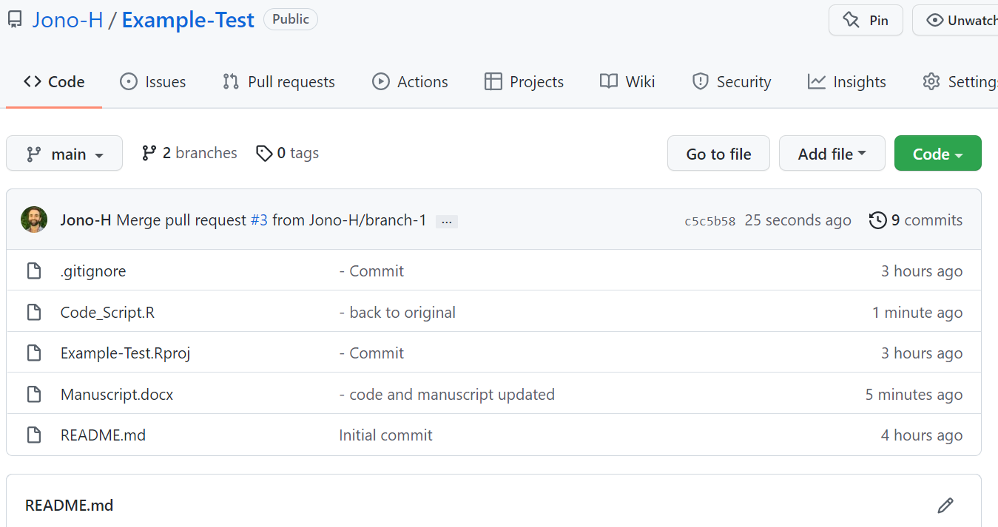
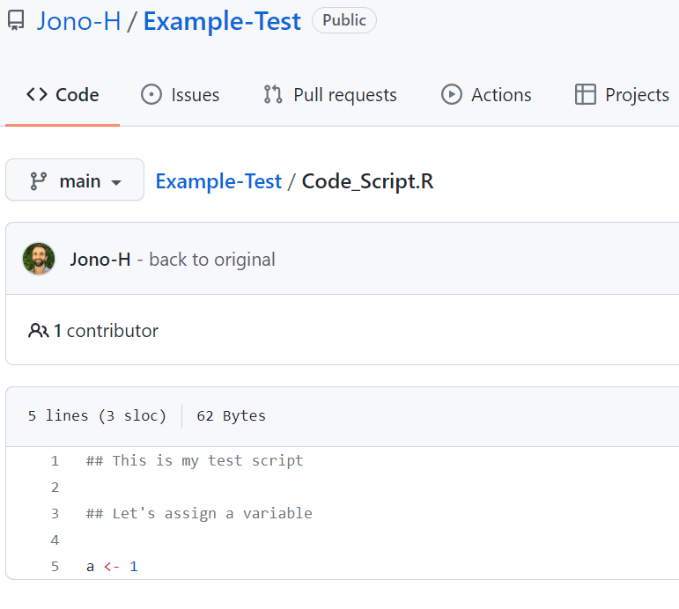
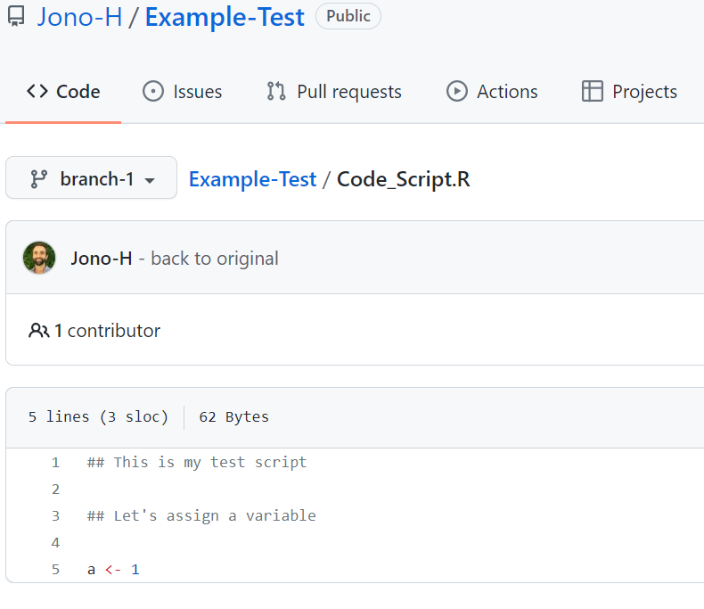
Typical GitHub workflow – from a bumbling biologists perspective
6: Create a Branch or Fork
Assuming, you have installed Git and Rstudio (v4 or greater)
After creating a new branch
The files should be the same
Open a file and it should be the same

Slide 19
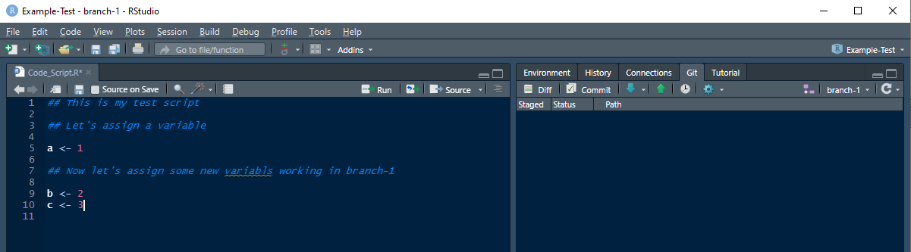
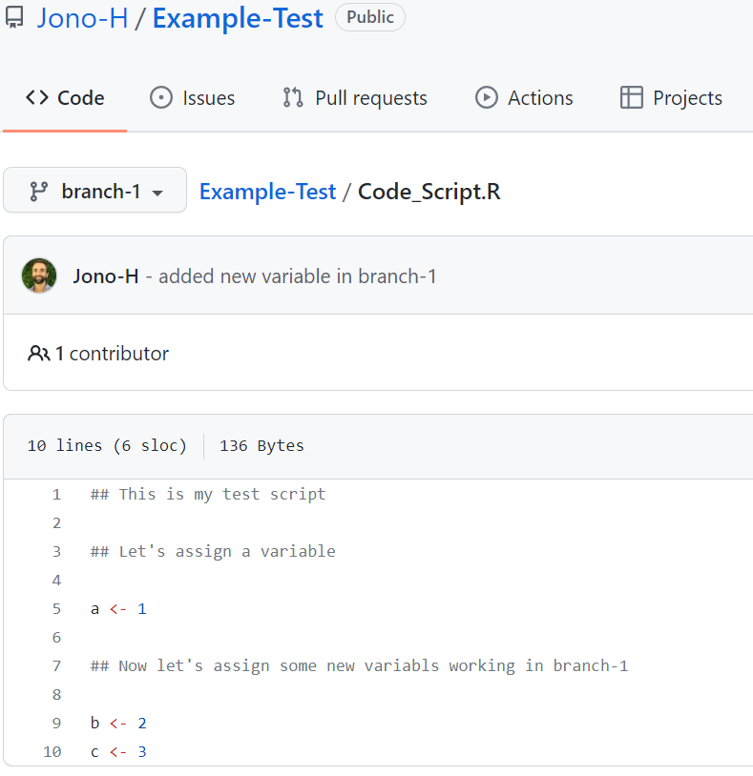
Typical GitHub workflow – from a bumbling biologists perspective
6: Create a Branch or Fork
Assuming, you have installed Git and Rstudio (v4 or greater)
1. In your new branch:
2. Modify a file
3. Save the file, Commit the file, Push it back to GitHub
3
1
2
Notice the new code in the different branch (called branch-1)

Slide 20
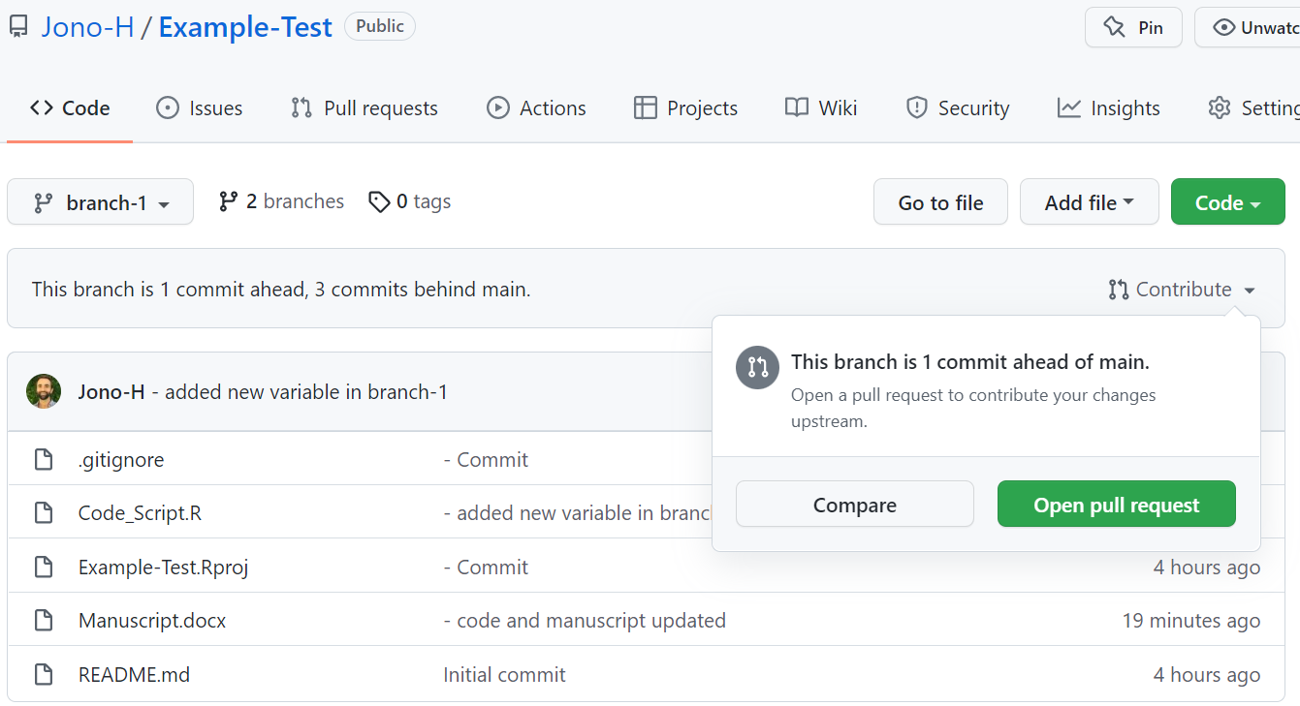
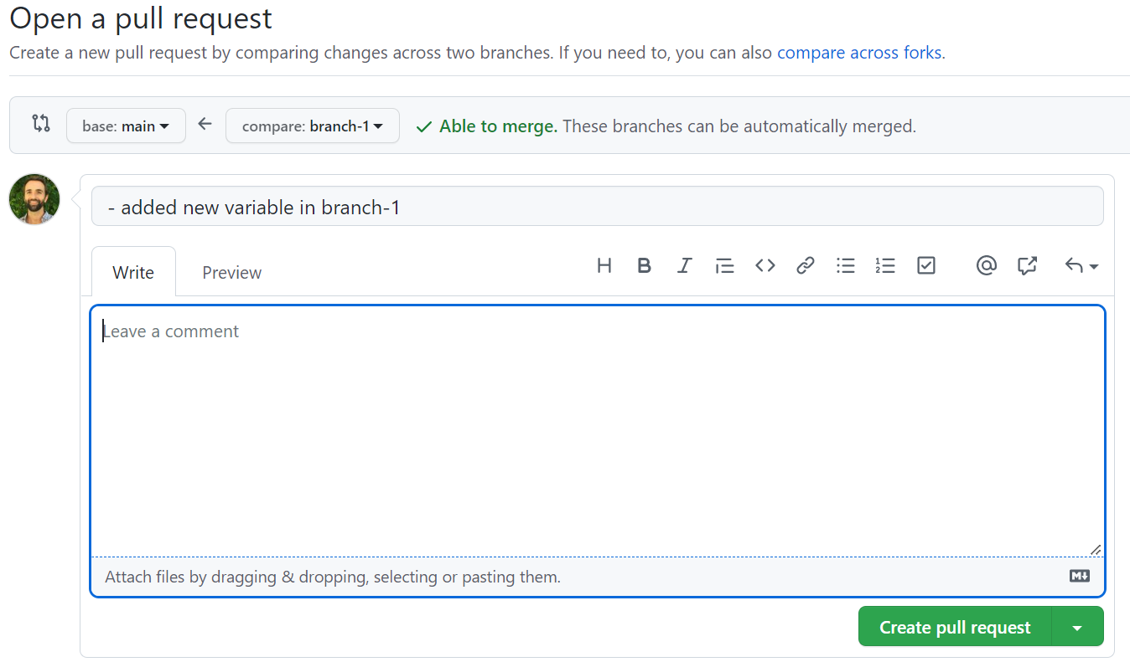
Typical GitHub workflow – from a bumbling biologists perspective
7: Submit and merge a Pull request
Assuming, you have installed Git and Rstudio (v4 or greater)
Submit a Pull Request
1
1
Under the contribute section select to ‘Open pull request’
Make sure you are working in the correct branch.
2
In the next window, you can create the pull request.
Note where you are pulling from and merging to.
2

Slide 21
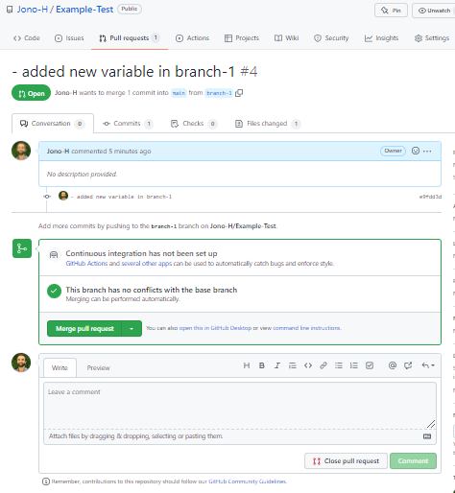
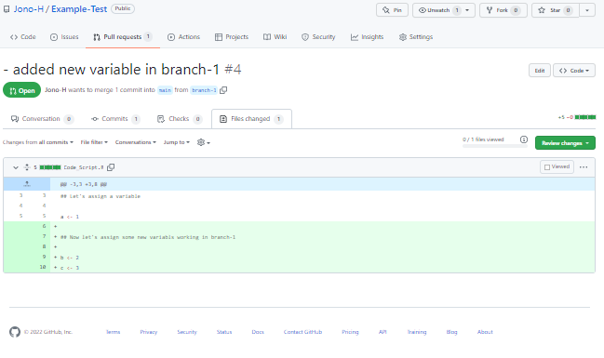
Typical GitHub workflow – from a bumbling biologists perspective
7: Submit and merge a Pull request
Assuming, you have installed Git and Rstudio (v4 or greater)
Merge a Pull Request
2
1
2. Or you can view how the file was changed, and then go back and merge the pull request.
The files from the different branches should now be the same! ☺
You can Merge the pull request immediately if you trust the changes

Slide 22
Typical GitHub workflow – from a bumbling biologists perspective
RECAP – Steps 1 - 7
Assuming, you have installed Git and Rstudio (v4 or greater)
So far, we have covered:
The basic workflow of what you will need if only working on code by yourself.
1: Create a repository (aka a repo)
If you want to work on and edit code with other people
The following will help:
2: Clone (aka copy or link) the repository to your computer
3: Pull the latest version of online code to your computer
6: Create a Branch or Fork
4: Stage – this is where temporary files on your computer live
7: Submit and merge a Pull request
5: Commit and Push the new files online to GitHub
REMEMBER: This is just one way of operating GitHub, there are lots of other ways out there!

Slide 23
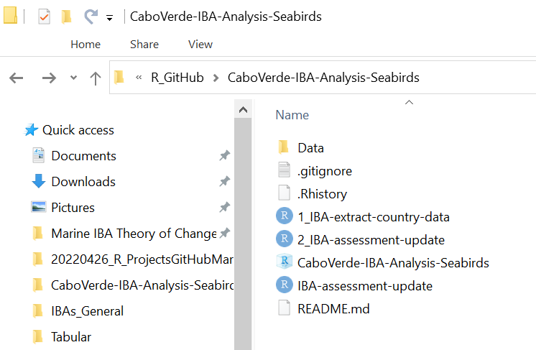
GitHub – data on your machine vs. online
See: .gitignore file
When you create a new repository -> you have option to create gitignore file.
In .gitignore file, you can create rules for things that git should ignore.
It can be worth “ignoring” large data files so they don’t go online.
Google rules about how to ignore different file types.

Slide 24
Resources to get you started (Markdown)
Online book: R Markdown: The Definitive Guide (https://bookdown.org/yihui/rmarkdown/)
Online book: R Markdown Cookbook (https://bookdown.org/yihui/rmarkdown-cookbook/)
LinkedIn Learning Course (requires payment): link here.
I found it useful to watch the lessons from this course and get a general overview of what functionality using Markdown exists.

Slide 25
Going from R Markdown to R Bookdown
To generate a “book” in R using Bookdown, you will need to understand how to use Markdown, and what Markdown is.

Slide 26
Installing and setting up R Markdown
For simple install option, see: https://bookdown.org/yihui/rmarkdown/installation.html
Note: Markdown gives you two types of key outputs
html (accommodating to lots of format options)
pdf (less accommodating, but useful if you need to print)
pdf outputs require you to have another computer language installed: LaTeX
There is a simple option in the link above for installing LaTex.

Slide 27
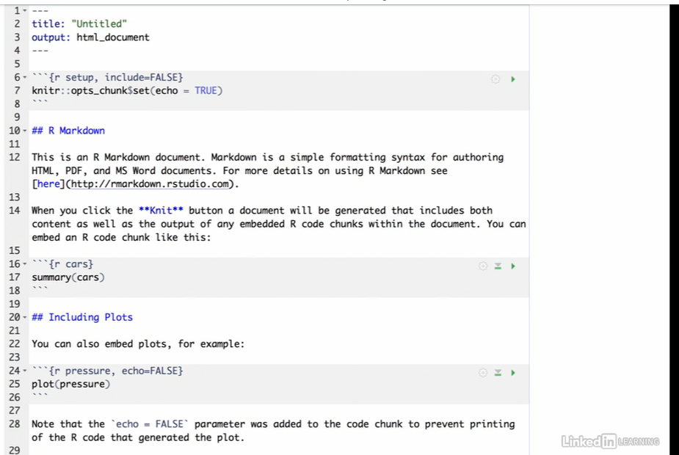
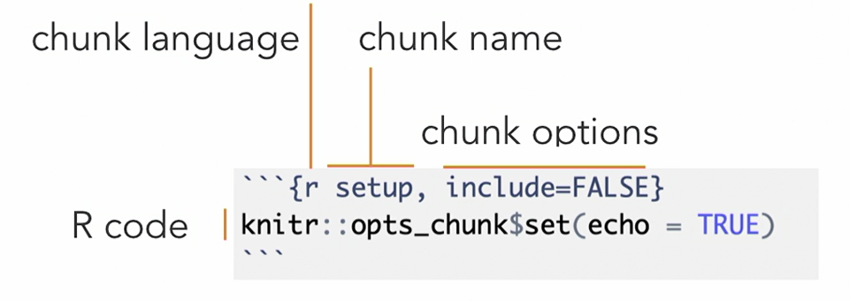
Markdown structure – the basics
Header of Markdown document:
written in YAML language
YAML is sensitive to indentation!
Text of Markdown document:
written in Pandoc flavoured Markdown
Code Chunks of Markdown document:
written in language that is specified
typically this will be R

